Slide 1
Court-Wilson
Neighbourhood Construction
July 2023

Slide 2
Welcome & Introductions
Presenters today are:
Karla Bailey, Vice President, System Planning Asset Management & Engineering
Mitch Dziurda, Design Engineer
Notes:
Christina

Slide 3
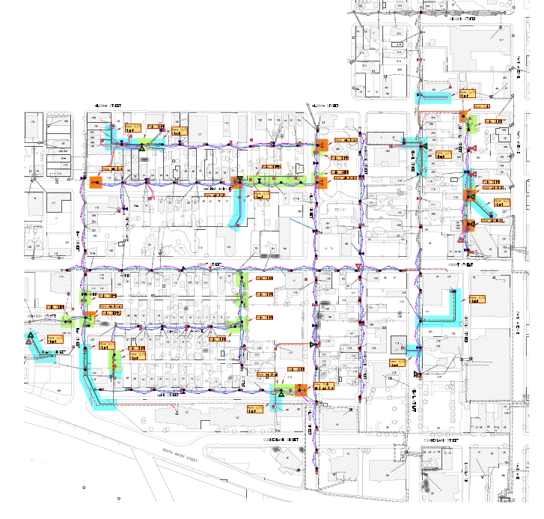
Court – Wilson Project Extents
Secord St
Bay St
Lincoln St
Cumberland St
Notes:
Colored lines indicate where new poles and wires will be, a full pdf map will be posted on the website for download and viewing afterwards.
Notice that Synergy North poles and wires are located in backyard easements throughout the area

Slide 4
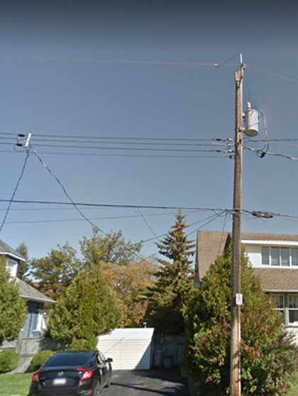
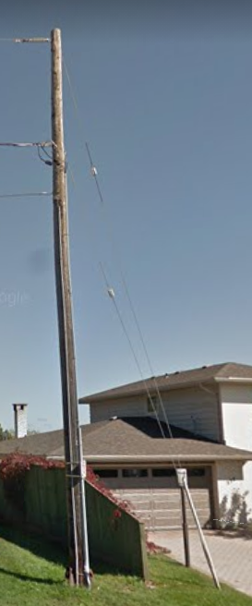
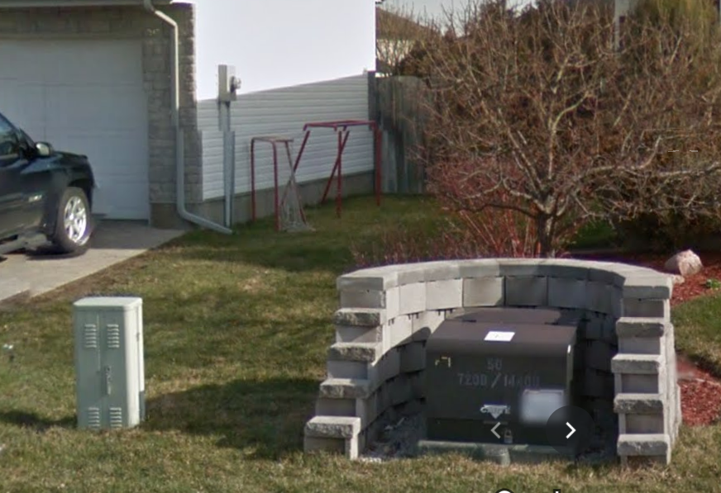
Synergy North Owned Assets
Transformer
Meter Base
Wires
Transformer
Pole
Anchor
Notes:
What we own – meters, transformers wires, poles
What we do not own – telecom boxes and wires on the bottom

Slide 5
What to expect when we’re in your neighbourhood
Pole Setting
Settling and backfill material
Access and Cranes
Double Poles
Outages
Occur during service changes
Traffic disruptions
Follow traffic rules, no closing of roads
Noise
OHSA guidelines
Notes:
Pole setting - Backfill material mounded to accommodate for settling
- Designated utility easement, SNC will be using cranes
Outages - Receive notice with point of contact if questions
Traffic - Several Vehicles, some will be subcontractors
- In construction zones – please slow down
Noise - Crews operate during 8-4 and follow the occupational health and safety act

Slide 6
Forestry
Notices
Will be sent to all customers prior to trimming
Encouraged to contact SNC to provide comments and discuss options for trees
Trimming
Site visits for vegetation that requires trimming
Trees could be cleared up to 3m to provide clearances from powerlines
All clippings will be cleaned and cleared
Notes:
1) Mail out notices to customers in project
2) Upon completion of a site visit Synergy North will determine the scope of work for each property
3) Customers will be contacted via mail and telephone to consult on the scope of work

Slide 7
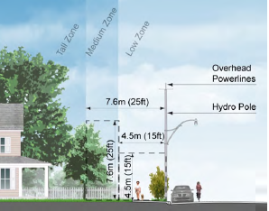
Forestry
“Plant the right tree in the right place”
Appropriate types, sizes, locations
Notes:
When looking at landscaping options, remember to consider height and location
Look at the mature height when planting near power lines and plant taller trees away from lines and only low compact species new power lines.
Coordinate with City of Thunder Bay on planting in boulevards

Slide 8
Court-Wilson Project
Statistics
Total Customers: 436, with 22 commercial services
102 new poles + 11 reframed poles
~9,948m new overhead wire
32 overhead transformers, 5 padmount transformers
Total project cost : $3,617,000
Notes:
Cost includes equipment, labour, trucking
Design team has been on site to discuss service changes with commercial customers

Slide 9
Typical Design Practices
Typical overhead projects are designed in a “like-for-like” manner
Most of the time locations for equipment remain
Changes where wire connects to the home will be discussed with individual customer
Notes:
“like-for-like” means that we replace it in the location where it existed, but for current standards and loads
All underground services will remain underground, connection at pole will be moved to new pole.

Slide 10
Court – Wilson Project Extents
Secord St
Bay St
Lincoln St
Cumberland St
Notes:
Colored lines indicate where new poles and wires will be, a full pdf map will be posted on the website for download and viewing afterwards.
Notice that Synergy North poles and wires are located in backyard easements throughout the area

Slide 11
System Changes highlighted
Orange
New pole, anchor or wire in a location where it did not exist prior
Blue
Moving overhead wires underground or underground replacement
Green
Change to the existing plant, extra wire or pole shift less than 5m
Notes:
Show a series of maps indicating where our replacement is not a “like-for-like” replacement

Slide 12
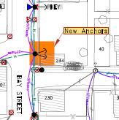
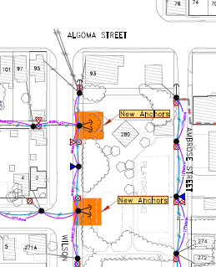
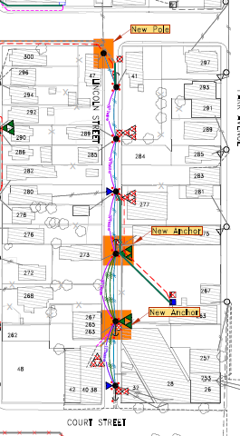
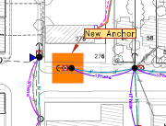
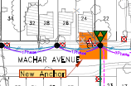
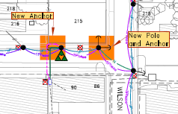
Orange Changes (new pole or anchor)
Notes:
Temporary for 5 years until the next phase is complete and wires are removed, anchors wont be needed.

Slide 13
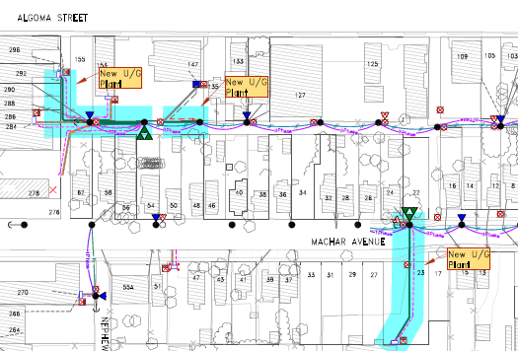
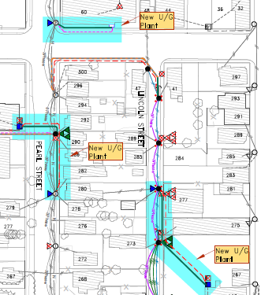
Blue Changes (wire movement)
Notes:
Temporary for 5 years until the next phase is complete and wires are removed, anchors wont be needed.

Slide 14
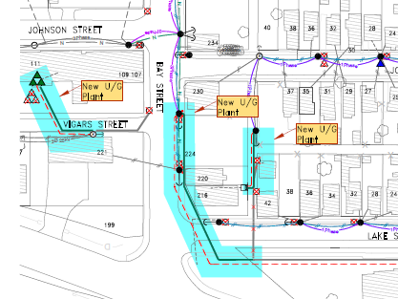
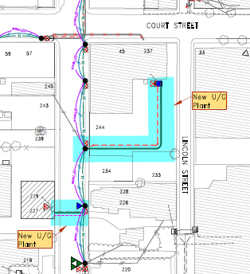
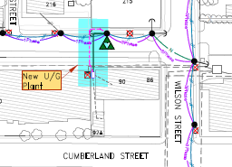
Blue Changes (New underground)
Notes:
Temporary for 5 years until the next phase is complete and wires are removed, anchors wont be needed.

Slide 15
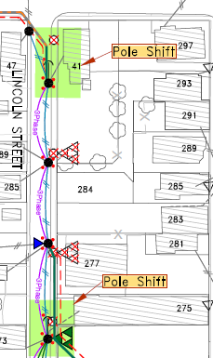
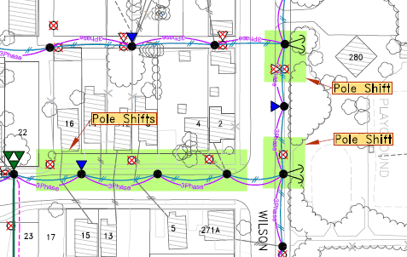
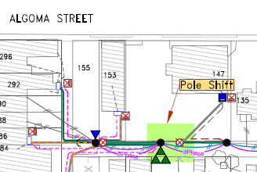
Green Changes (Pole Shift)
Notes:
Temporary for 5 years until the next phase is complete and wires are removed, anchors wont be needed.

Slide 16
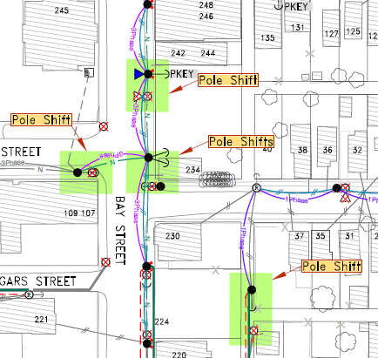
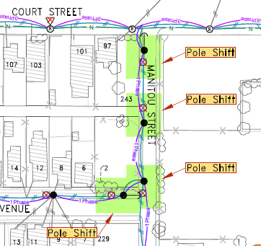
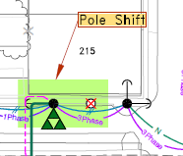
Green Changes (Pole Shift)
Notes:
Temporary for 5 years until the next phase is complete and wires are removed, anchors wont be needed.

Slide 17
Schedule
2023
Forestry (Completed)
Surveying (Completed)
Staking (Next 2 weeks)
Pole Set (September)
2024
Overhead work (Complete end of 2024)
Notification to Other Attachments (SL, Comm)
Notes:
Certain types of work are seasonal – ie. with reference to leaves on trees and when the ground is thawed and dry
Explain Surveying
Our timing can change based on snow thaw and freeze

Slide 18
When You Can Expect To Hear From Us
Neighbourhood Meeting
Optional Forestry Notice (phone call or email)
Notice of Project (letter mail – 3 weeks prior to construction )
Outage Notice (letter mail or automated call)
Notes:
When you can expect to hear from Synergy North
Neighbourhood meeting before any work to begin
Forestry notice if trees being cut 2-3 weeks before cut
Notice of Project is usually 3 weeks before construction – next year
Obstructions notice - which doesn’t allow us to access existing pole location or new pole location
Outage notice is one week letter mail and automated call

